Slide 1


A technique for the total ozone columns retrieval using spectral measurements of the IKFS-2 instrument
Методика измерений общего содержания озона по спектральным измерениям прибора ИКФС-2
Alexander Polyakov¹, Yana Virolainen ¹, Yuriy Timofeyev ¹, George Nerobelov ¹, Dmitry Kozlov ²
¹SPBU, Ozone Layer and Upper Atmosphere Research Laboratory
² Keldysh Research Center
Александр Поляков ¹, Яна Виролайнен ¹, Юрий Михайлович Тимофеев ¹, Георгий Неробелов ¹, Дмитрий Козлов ²
¹СПбГУ, Лаборатория исследований озонового слоя и верхней атмосферы
² Исследовательский центр имени М.В.Келдыша
DLCP-2023 June 21-23, 2023

Slide 2
Atmospheric ozone plays an important role in the Earth's biosphere by absorbing dangerous solar UV radiation and by contributing to the climate formation. Only satellite measurement methods can provide data on the global distribution of ozone and its anomalies.
We present a technique for estimating the total ozone columns (TOCs) from outgoing IR radiation spectra based on the artificial neural networks (ANNs). The technique was applied to the spectral measurements of the IKFS-2 instrument aboard the Russian meteorological satellite Meteor M N2 in 2015-2020, using data from the OMI instrument for the ANN training.
A validation of the TOC retrievals was carried out based on comparison with ground-based and satellite measurements data. The average differences between the IKFS-2 data and independent TOC measurements are less than 2%, the standard deviations of the differences (SDDs) vary from 2 to 4%.

Slide 3
Outline
The value of stratospheric ozone, methods for measuring ozone
IKFS-2 instrument aboard “Meteor M N2”
Spectral data inversion. Artificail Neural Network (ANN)
Principle Component Analysis
Techinque, process and results of ANN training
Validation of IKFS-2 TC measurements, it’s advantages
Examples of the results
Conclusion

Slide 4
As you well know, the ozonosphere is vital for the existence of mankind. Only the emergence of the ozonosphere allowed life to come to land from the ocean.
One of the hypotheses explains the Devonian extinction by a significant decrease in the ozone content in the atmosphere (link below).
The story of a sharp drop in the ozone content and the formation of ozone holes in the Antarctic due to anthropogenic pollution of the atmosphere with chlorine-fluorine carbons and the resulting restrictions and a ban on the production and use of the latter is widely known.
UV-B radiation was the Devonian-Carboniferous boundary terrestrial extinction kill mechanism
John E. A. Marshall https://orcid.org/0000-0002-9242-3646 Jon LakinIan Troth https://orcid.org/0000-0002-9998-9781and Sarah M. Wallace-JohnsonAuthors Info & Affiliations
Science Advances • 27 May 2020 • Vol 6, Issue 22 • DOI: 10.1126/sciadv.aba0768

Slide 5
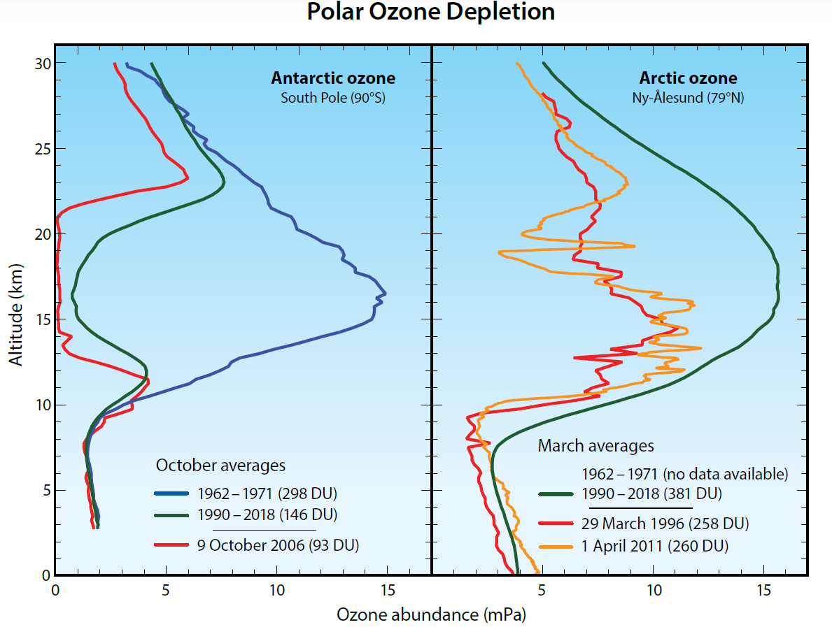

Slide 6
Methods for measuring the ozone content in the atmosphere
In situ: near surface, aircraft, balloon (ozonesondes)
Remote
  Grouns – based (local)
  1. Direct Solar Radiation: IR,UV, VID
  FTIR; Dobson and Brewer instruments – «reference standard»
  2. Scattered solar radiation UV, VID, NIR
  3. Scattered solar radiation at low Sun (Umkehr)
  4. Microwave thermal radiation
  5. Lidars
  2. Satellire (global)
    Scattered-reflected solar radiation (OMI, TROPOMI)
    Transmittance - Solar occultation (ACE-FTS), stars
    Outgoing thermal IR radiation (IASI, CrIS, IKFS-2 etc)
    Microwave radiation (limb - MLS)
    Measurements of emissions in UV, VIS and NIR regions of the spectrum

Slide 7
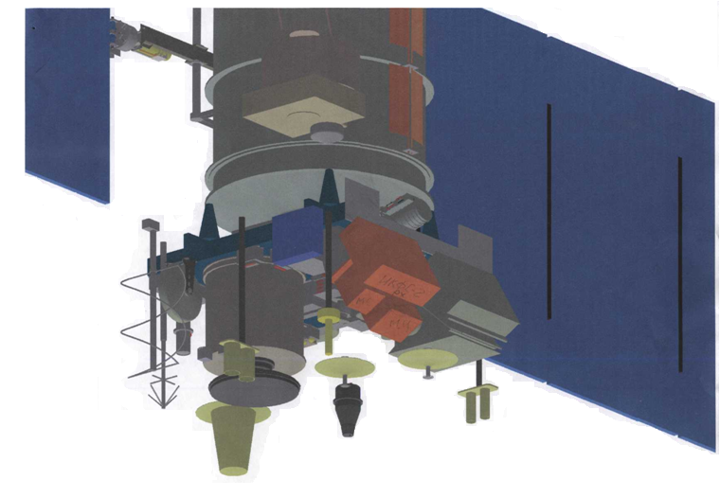
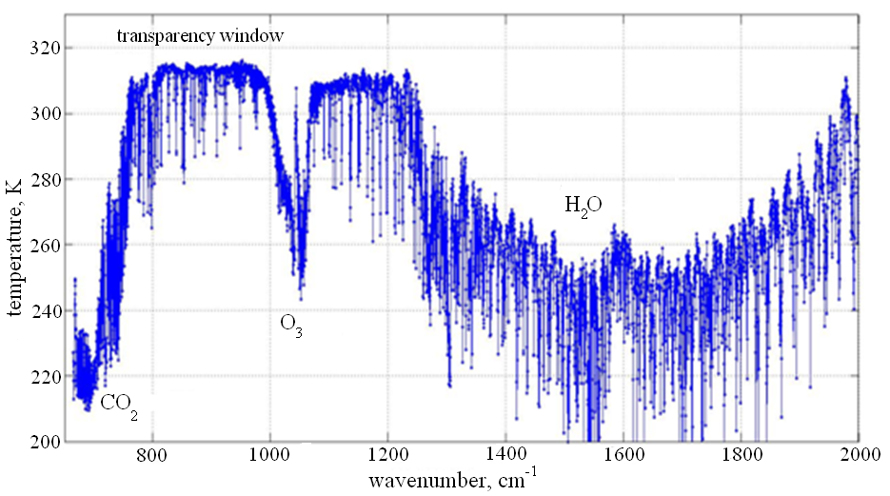
IKFS-2 instrument specifications 1
Space borne infrared Fourier-transform spectrometer IKFS-2 measures outgoing infrared radiance and provides data on the atmosphere for numerical weather prediction and other various applications.
IKFS-2 is one of the key instruments of the Meteor-M №2 satellite. The instrument was developed by Keldysh Research Center together with Krasnogorsky zavod and Bauman State Technical University (Moscow).
IKFS-2

Slide 8

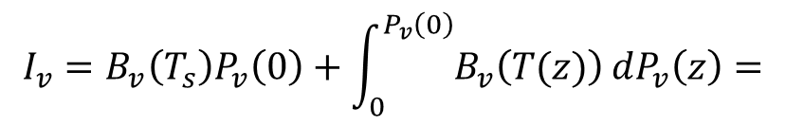
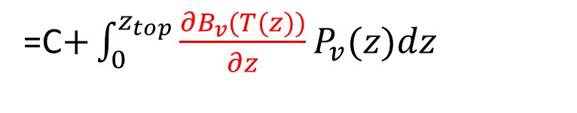
Inversion of spectral measurements
Thermal radiation of the atmosphere-surface system (black surface)
$$I_{v}=B_{v}\left(T_{s}\right)P_{v}\left(0\right)+\int_{0}^{P_{v}\left(0\right)}{B_{v}\left(T(z)\right)}dP_{v}\left(z\right)=$$
${=B}_{v}\left(T_{s}\right)P_{v}\left(0\right)+\int_{0}^{z_{top}}{B_{v}(T(z))\frac{∂P_{v}(z)}{∂z}dz}$=
=С$+\int_{0}^{z_{top}}{\frac{{∂B}_{v}(T(z))}{∂z}P_{v}(z)dz}$

Slide 9
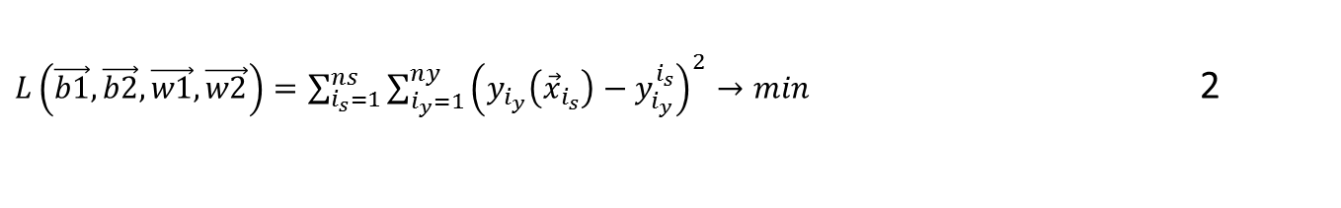
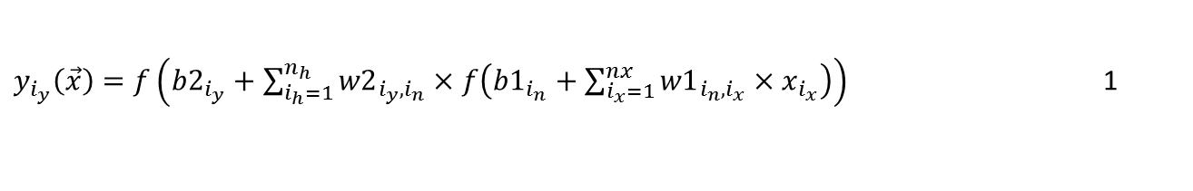
Artificial Neural Network
$y_{i_{y}}\left(\vec{x}\right)=f\left({b2}_{i_{y}}+\sum_{i_{h}=1}^{n_{h}}{{w2}_{{i_{y},i}_{n}}×f\left({b1}_{i_{n}}+\sum_{i_{x}=1}^{nx}{{w1}_{i_{n},i_{x}}×x_{i_{x}}}\right)}\right)$ 1
cost function - Minimizing of output parameter errors
$L\left(\vec{b1},\vec{b2},\vec{w1},\vec{w2}\right)=\sum_{i_{s}=1}^{ns}{\sum_{i_{y}=1}^{ny}{{\left(y_{i_{y}}\left({\vec{x}}_{i_{s}}\right)−y_{i_{y}}^{i_{s}}\right)}^{2}}}→min$ 2
Principle Components Analysis + Artificial Neural Network

Slide 10



Principle Component Analysis
$$I\left(v\right)=\overline{I}\left(v\right)+U\vec{w}$$
$$U$$
- Empirical orthogonal functions (EOF), eigenvectors of the covariance matrix of spectra
$$\vec{w}$$
- Principle Components (PC), Expansion coefficients, coordinates in the basis of EOF,

Slide 11
Technique, process and training results
Algorithm for constructing the decision operator
Preparation of data for the training sample
  Preparation of IKFS-2 spectral measurements (168,758,753 spectra from 2105 to November 2020 - all data with a swath width 1000 km)
  Preparation of ozone TC data, in this case, OMI data for the same period.
  Calculation of the average spectrum, covariance matrices, EOF.
2. Building a training sample
1. Measurement pair matching (70 km, 5 hours –> 16,991,382 pairs)
2. Calculation of the PC and assembly of the training sample
3. ANN training (expression (2) minimization)
4. Testing of various ANNs (different number of PCs, hidden layer neurons, inclusion of latitudinal-seasonal parameters in predictors)

Slide 12
Some variants of ANN - approximation errors
NPC total | NPC O3 | Nh | N param. | Approximation error, DU.
Predictors - angle and PC
25 | 50 | 30 | 2341 | 8.885
Predictors - latitude, day of the year, angle and PC
25 | 50 | 30 | 2401 | 8.361
25 | 50 | 40 | 3201 | 8.245
30 | 60 | 50 | 4751 | 8.055
30 | 60 | 40 | 2851 | 8.207
30 | 50 | 45 | 3826 | 8.138
30 | 50 | 40 | 3401 | 8.202
20 | 50 | 30 | 2251 | 8.425

Slide 14
Comparison two kinds of ANN vs ground-based measurement data
Network | Comparison number | 25-50-30 |  | 30-60-50
 |  | bias | SD | bias | SD
WODC | 344412 | -0.81 | 2.94 | -0.82 | 2.91
Eubrewnet | 195913 | -0.56 | 2.90 | -0.55 | 2.93

Slide 15
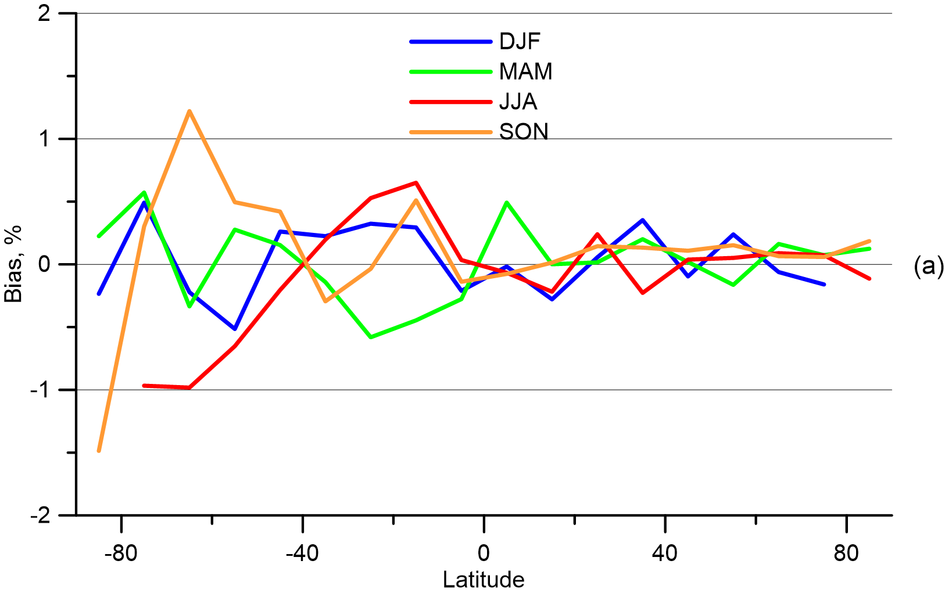
Latitudinal Variation of the Average ANN Training Error (average ozone TC Approximation Error Based on OMI Data) for Different Seasons.

Slide 16
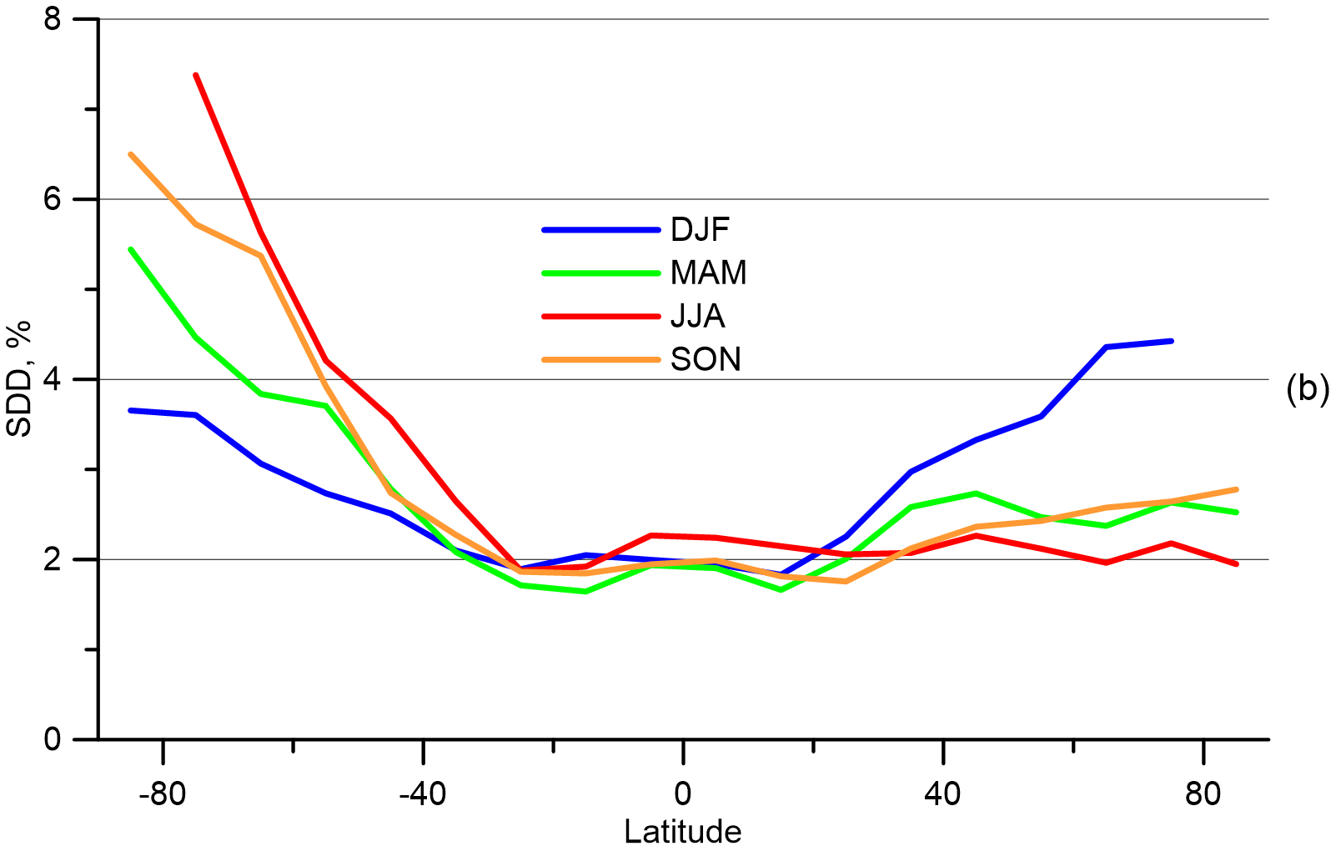
Latitudinal Variation of the SD ANN Training Error (SD of ozone TC Approximation Error Based on OMI Data) for Different Seasons.

Slide 17
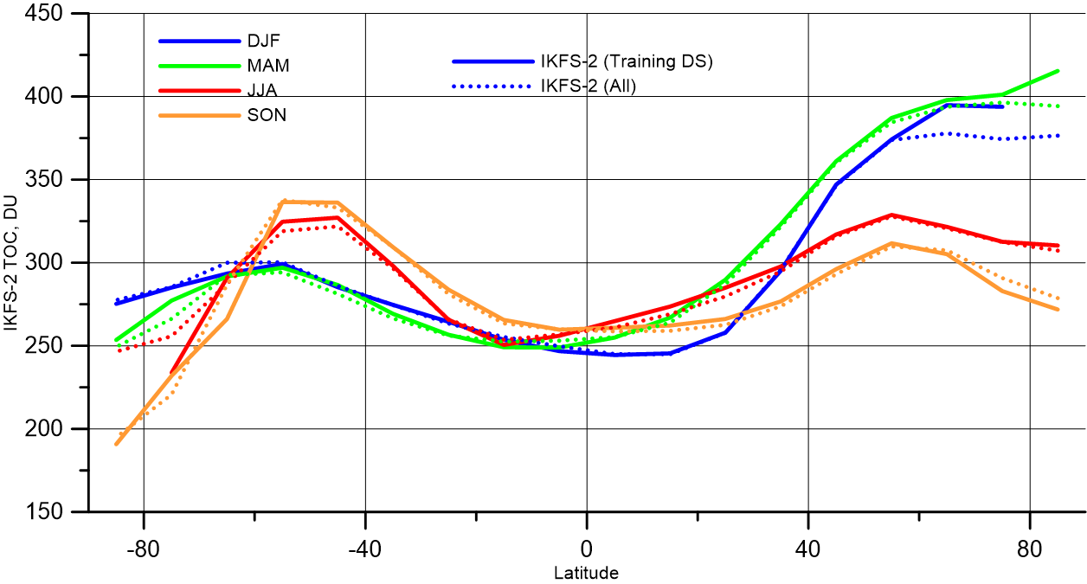
Latitudinal Variation of the ozone TC on the training data set and on the whole IKFS-2 measurement ensemble for 2015–2020.

Slide 18
Results and validation

Slide 19
Validation of IKFS-2 measurement results based on ground-based ozone TС measurements.
To validate the IKFS-2 measurements, we used hourly measurements by ground sites equipped with Brewer and Dobson instruments.
WOUDC network data and Eubrewnet network data were used.
Only direct sun measurements were used.
Criteria for match of satellite and ground data (1 hour and distance less than 70 km) were obtained earlier.

Slide 20
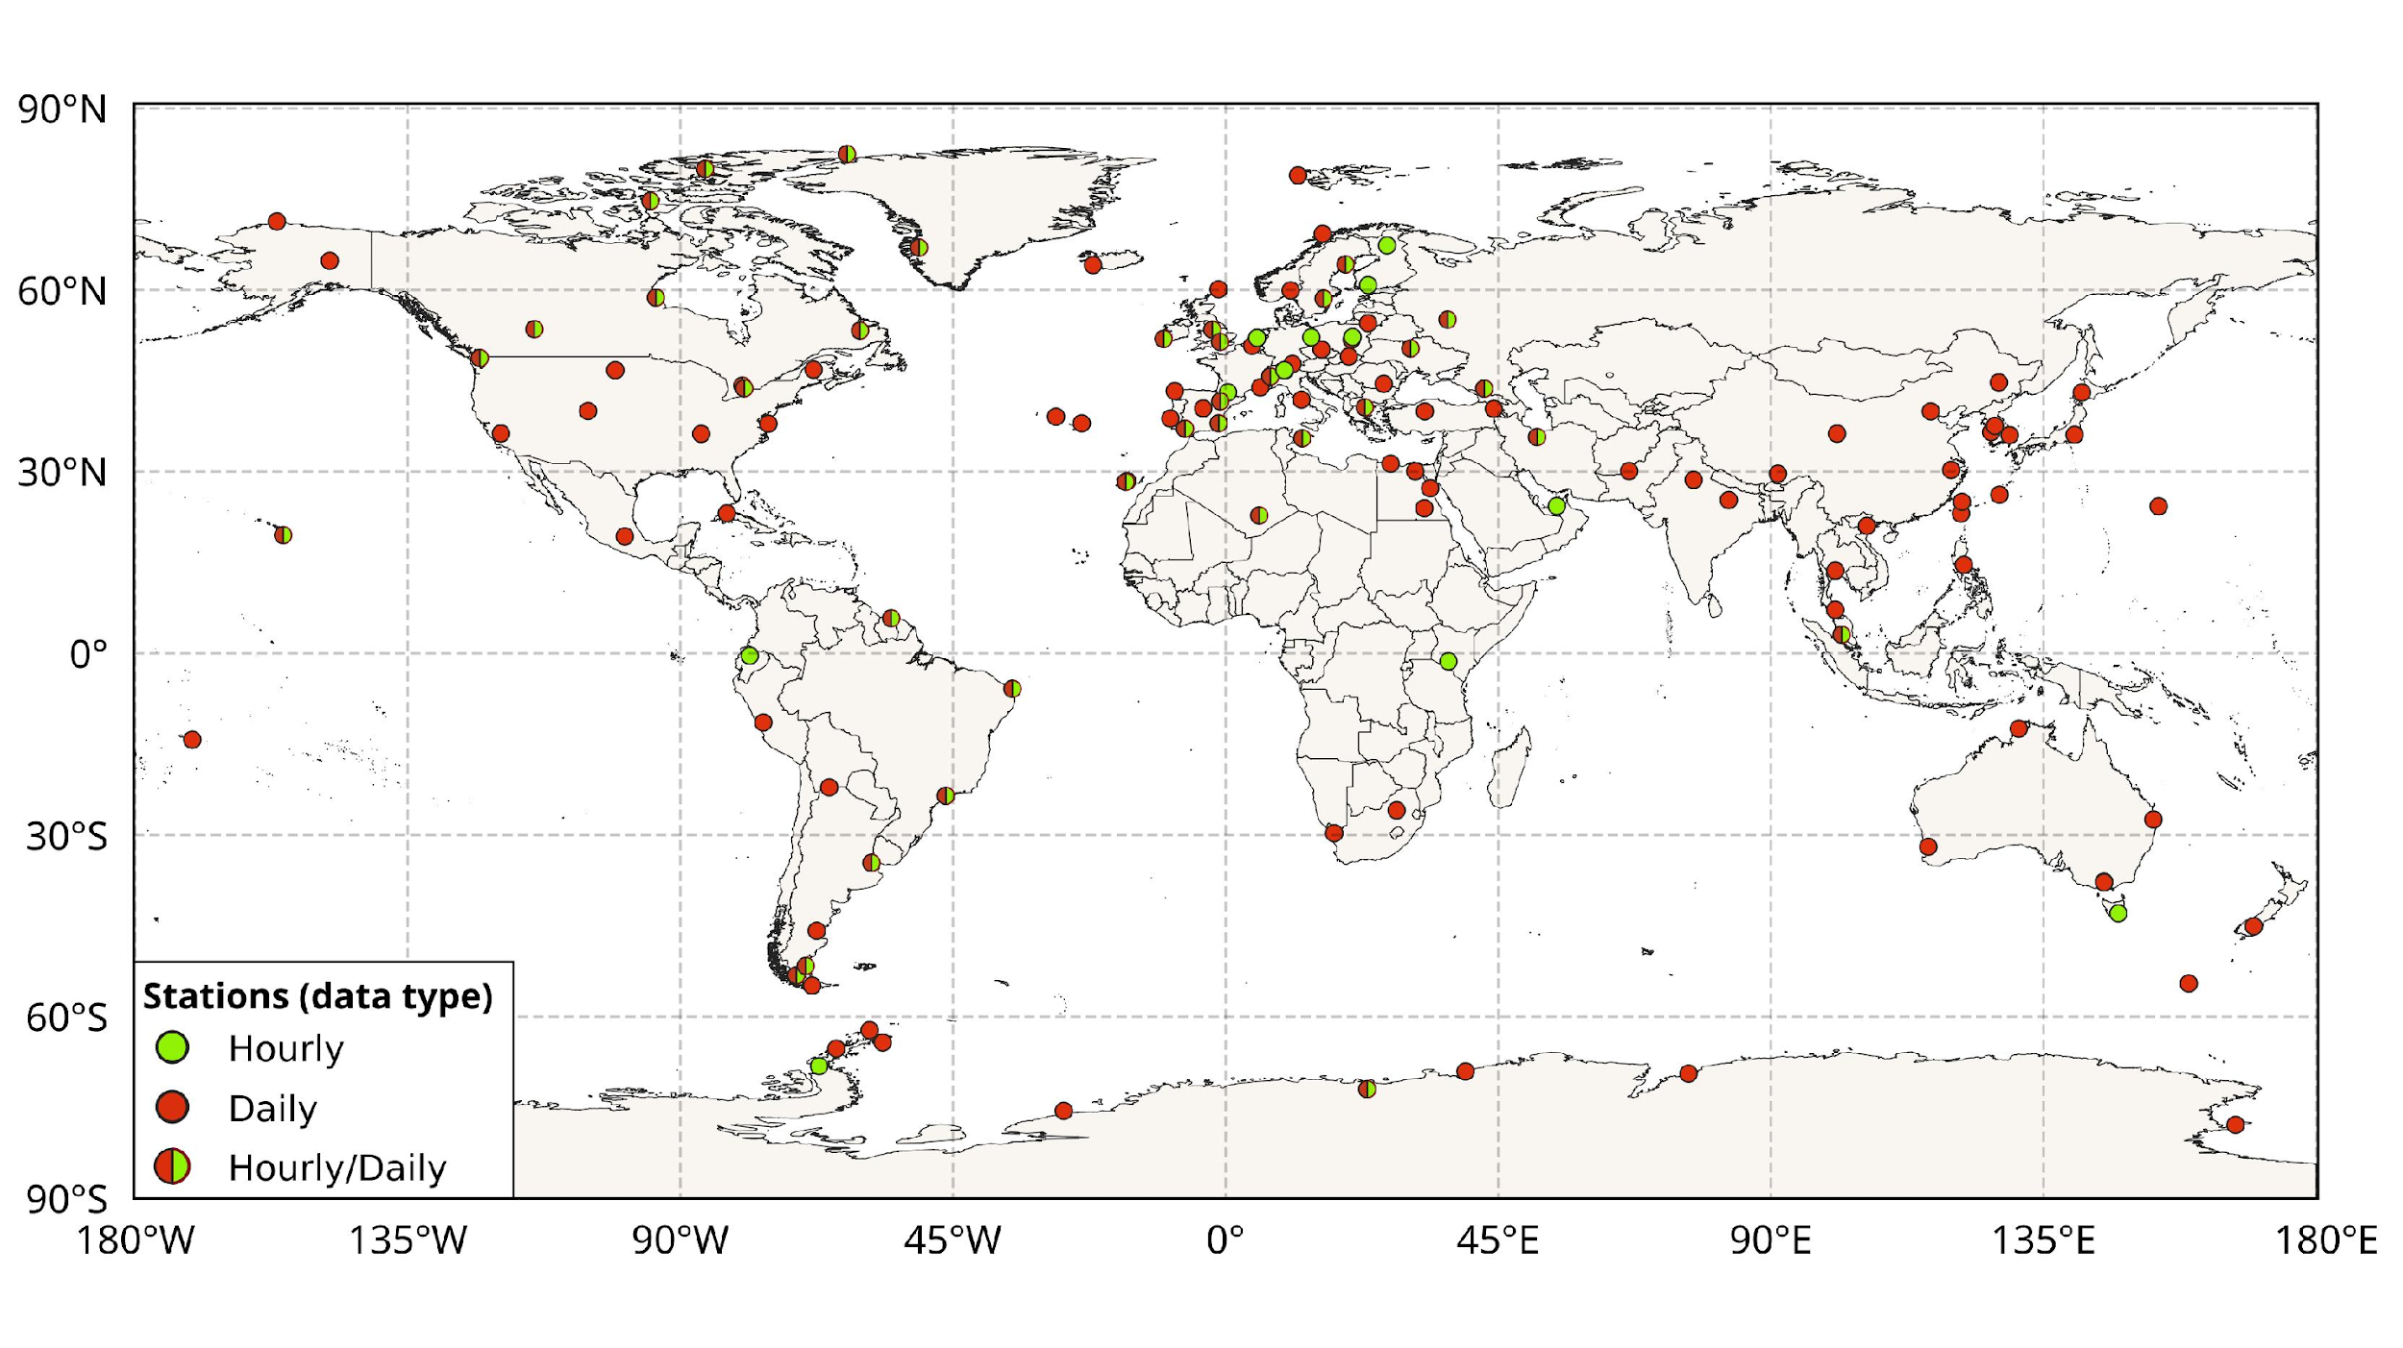
Location of ground-based stations equipped with Brewer and Dobson TOC instruments.
Only the stations whose data were used to validate the IKFS-2 data are given.

Slide 21
Comparison versus hourly GB Data
Station | Latitude | Longitude | Altitude | Instrument | Number | Bias, % | SD, %
Eureka | 80.05 N | 86.42 W | 9 | Brewer | 82,767 | −0.2 | 2.6
Resolute | 74.70 N | 94.97 W | 68 | Brewer | 11,979 | −0.6 | 2.1
Churchill | 58.75 N | 94.07 W | 26 | Brewer | 8360 | −1.6 | 3.0
Obninsk | 55.10 N | 36.61 E | 100 | Brewer | 1044 | −0.2 | 2.7
Edmonton | 53.55 N | 114.11 W | 752 | Brewer | 8496 | 1.0 | 3.1
Goose Bay | 53.31 N | 60.36 W | 26 | Brewer | 11,752 | 0.0 | 2.2
Lindenberg | 52.21 N | 14.12 E | 127 | Brewer | 9472 | −1.3 | 2.9
De Bilt | 52.10 N | 5.18 E | 24 | Brewer | 12,558 | −2.6 | 2.1
Kyiv-Goloseyev | 50.36 N | 30.40 E | 206 | Dobson | 3763 | −0.1 | 1.9
Saturna Island | 48.77 N | 123.13 W | 202 | Brewer | 7686 | 0.4 | 2.6
Aosta | 45.74 N | 7.36 E | 570 | Brewer | 1022 | 0.3 | 2.0
Egbert | 44.23 N | 79.78 W | 264 | Brewer | 7493 | −1.6 | 2.1
Lannemezan | 44.13 N | 0.37 E | 590 | Dobson | 131 | 2.4 | 2.0
Toronto | 43.78 N | 79.47 W | 202 | Brewer | 50,937 | −1.0 | 2.2
Kislovodsk | 43.73 N | 42.66 E | 2070 | Brewer | 3783 | 1.6 | 2.4
Thessaloniki | 40.63 N | 22.96 E | 60 | Brewer | 6959 | −1.0 | 2.2
University of Tehran | 35.73 N | 51.38 E | 1419 | Dobson | 674 | 1.1 | 2.0
Mauna Loa (HI) | 19.54 N | 155.58 W | 3397 | Brewer | 24,581 | 3.2 | 3.5
Paramaribo | 5.81 N | 55.21 W | 16 | Brewer | 10,880 | −0.5 | 2.1
Natal | 5.83 S | 35.21 W | 49 | Dobson | 32 | 0.5 | 1.2
Cachoeira-Paulista | 22.69 S | 46.20 W | 574 | Dobson | 26 | −3.5 | 1.6
All sites |  |  |  |  | 344412 | −0.8 | 2.9
WODC
Difference IKFS-2 minus ground-based data, %.
Brewer and Dobson instruments: Bias = -0.8% SDD = 2.9%
Only Dobson Bias=0.1%, SD=2.04%

Slide 22
Station | Latitude | Longitude | Altitude | Number | Bias | SD
Sodankyla | 67.37° N | 26.63° E | 100 m | 13,409 | 0.5 | 2.2
Sondrestrom | 67.00° N | 50.52° W | 150 m | 10,742 | −0.8 | 3.7
Vindeln | 64.24° N | 26.63° E | 225 m | 12,139 | −1.1 | 3.0
Jokioinen | 60.81° N | 23.50° E | 106 m | 1041 | −1.6 | 2.7
Norrkoping | 58.58° N | 16.15° E | 43 m | 16,162 | −0.9 | 2.1
Obninsk | 55.10° N | 36.61° E | 100 m | 616 | −3.0 | 2.7
Manchester | 53.47° N | 2.23° W | 76 m | 5871 | −2.5 | 2.3
Warsaw | 52.25° N | 20.94° E | 120 m | 4841 | −1.9 | 1.9
Valentia | 51.94° N | 10.25° W | 14 m | 5799 | −2.0 | 2.4
Reading | 51.44° N | 0.94° W | 61 m | 7958 | −2.7 | 2.7
Arosa | 46.78° N | 9.67° E | 1840 m | 14,249 | −0.3 | 2.0
Aosta | 45.74° N | 7.36° E | 570 m | 6823 | 0.5 | 2.6
Zaragoza | 41.63° N | 0.91° W | 250 m | 5843 | −2.0 | 3.3
Thessaloniki | 40.63° N | 22.96° E | 60 m | 7503 | −0.3 | 2.5
Murcia | 38.00° N | 1.17° W | 69 m | 4744 | −2.3 | 1.6
El Arenosillo | 37.10° N | 6.73° W | 41 m | 9662 | −1.1 | 2.1
Lampedusa | 35.52° N | 12.63° E | 50 m | 502 | −1.3 | 2.1
Izana | 28.31° N | 16.50° W | 2370 m | 27,809 | 2.3 | 1.6
Abu Dhabi | 24.34° N | 54.64° E | 20 m | 3682 | −1.4 | 3.3
Tamanrasset | 22.79° N | 5.53° E | 1320 m | 12,104 | −1.8 | 2.0
Petaling Jaya | 3.10° N | 101.65° E | 46 m | 4816 | −1.3 | 1.6
Izobamba | 0.37° S | 78.55° W | 3058 m | 167 | −1.2 | 2.4
Nairobi | 1.30° S | 36.76° E | 1795 m | 865 | 0.3 | 2.3
Buenos Aires | 34.59° S | 58.48° W | 25 m | 364 | −1.6 | 1.3
Hobart | 42.90° S | 147.33° E | 20 m | 12,462 | 0.0 | 2.7
Rio Gallegos | 51.60° S | 69.32° W | 5 m | 2390 | −1.0 | 3.6
Punta Arenas | 53.14° S | 70.88° W | 22 m | 3895 | 3.3 | 3.4
San Marten | 68.13° S | 67.11° W | 30 m | 126 | 2.2 | 3.6
Princess lisabeth | 71.95° S | 23.35° E | 1390 m | 345 | −0.8 | 3.0
Comparison versus hourly GB Data
Eubrewnet
Difference IKFS-2 minus ground-based data, %.
All sites:
Bias = -0.40%
SD = 2.7%

Slide 23
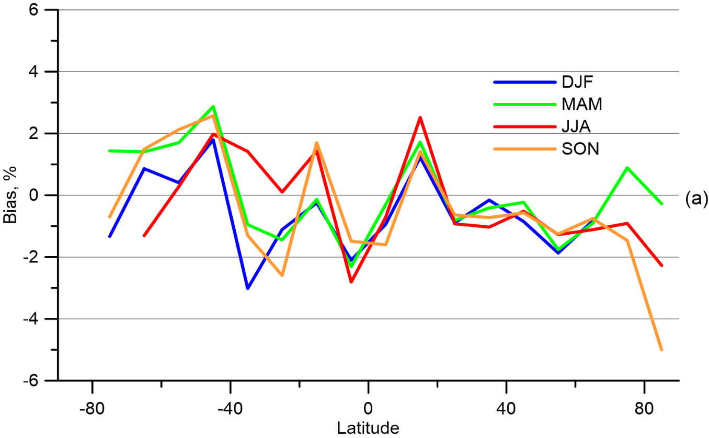
Comparison versus Daily Dobson and Brewer Data
bias equals −0.59%,
Latitudinal and seasonal variation of TOC bias between IKFS-2 and ground-based WOUDC daily measurements relative to the ground-based data; DJF—Dec., Jan, Feb; MAM—Mar., Apr., May; JJA—June, July, Aug.; SON—Sep., Oct., Nov.;

Slide 24
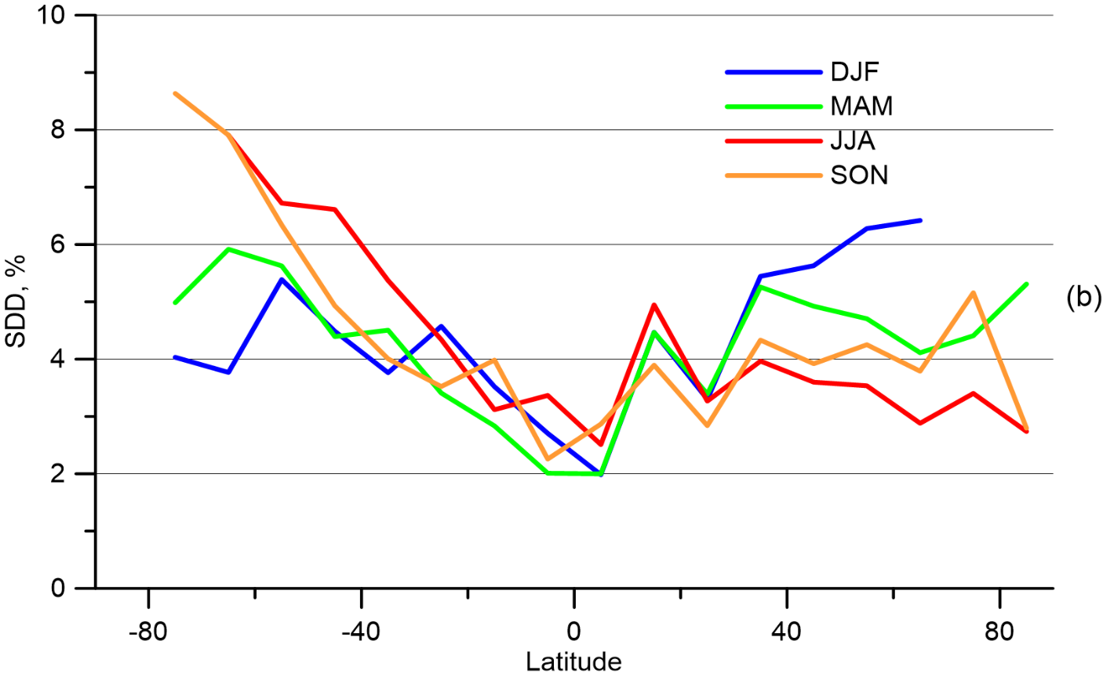
Comparison versus Daily Dobson and Brewer Data
SDD equals 4.5%.
Latitudinal and seasonal variation of TOC SDD between IKFS-2 and ground-based WOUDC daily measurements relative to the ground-based data; DJF—Dec., Jan, Feb; MAM—Mar., Apr., May; JJA—June, July, Aug.; SON—Sep., Oct., Nov.;

Slide 25
Validation of IKFS-2 measurements based on TROPOMI measurements.
The S5P satellite with a TROPOMI instrument onboard was launched on 13 Oct 2017. (http://www.tropomi.eu/). For the comparisons we used the Level 2 data since May 2018. The spatial resolution of TROPOMI is less than 10 km. The data was filtered by a quality flag greater than 0.9. We used TOC data with a temporal mismatch of 6 h. We considered the TROPOMI TOC data in the 100–650 DU range. The number of data pairs compared is ~1.4 × 10⁹. The bias and SDD between the IKFS-2 and TROPOMI constitute -1.2% and 2.8%.

Slide 26
OMI and TROPOMI instruments, using solar radiation, unlike IKFS-2, cannot observe the occurrence of ozone anomalies in winter. As an example, let us present a figure with daily TO fields in the region of Antarctica in July 2020, which is characterized by the early appearance of ozone holes.

Slide 27
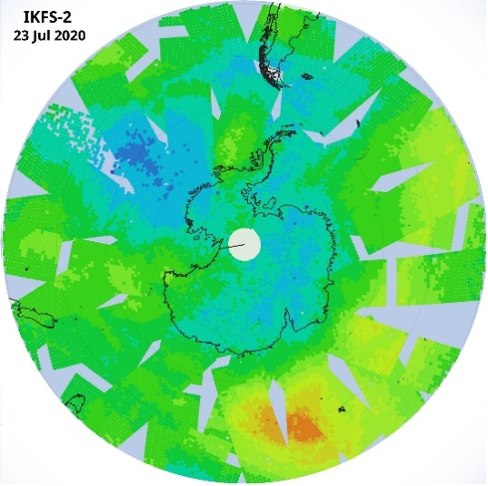
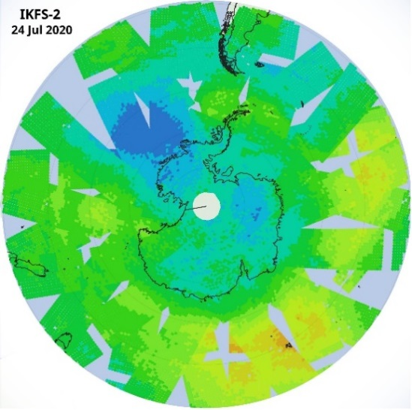
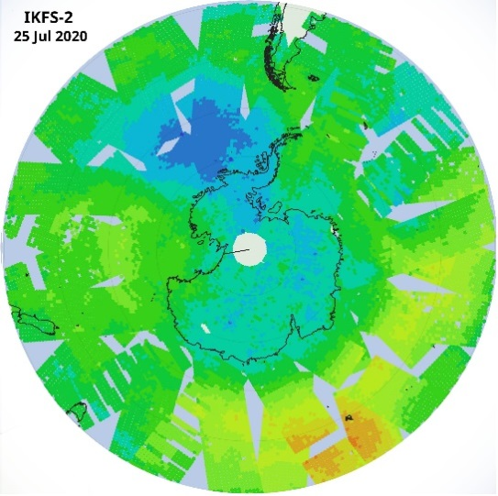
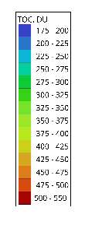
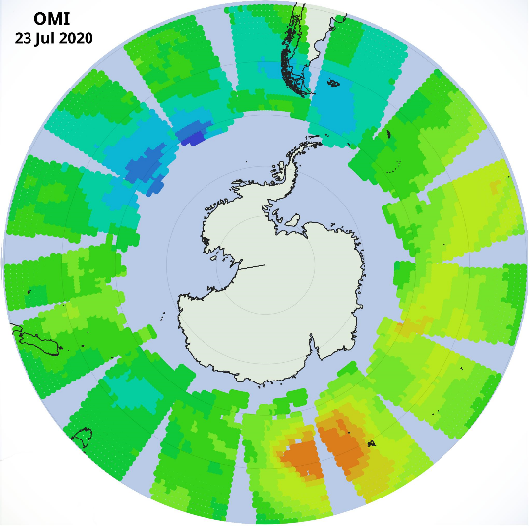
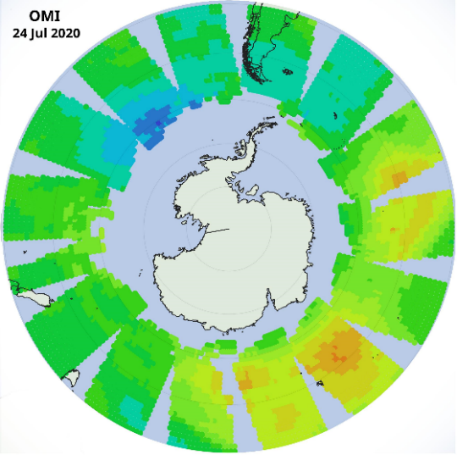
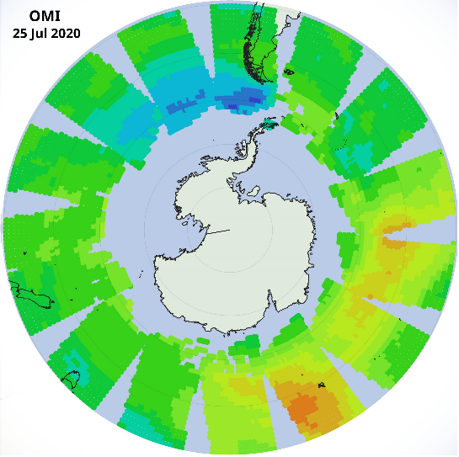
2020, July,
23
24
25
IKFS-2
OMI

Slide 28
A similar adventage is observed in the Northern Hemisphere, which has recently also been characterized by significant ozone anomalies in some years. The figure on the next slide shows the average monthly ozone TC fields in the Northern Hemisphere in the Arctic and Subarctic latitudes in the winter of 2019–2020, when the early occurrence of the polar stratospheric vortex was observed, which led to subsequent ozone anomalies in the spring of 2020.

Slide 29
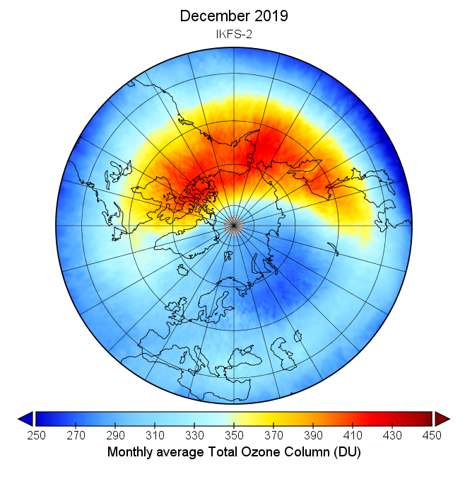
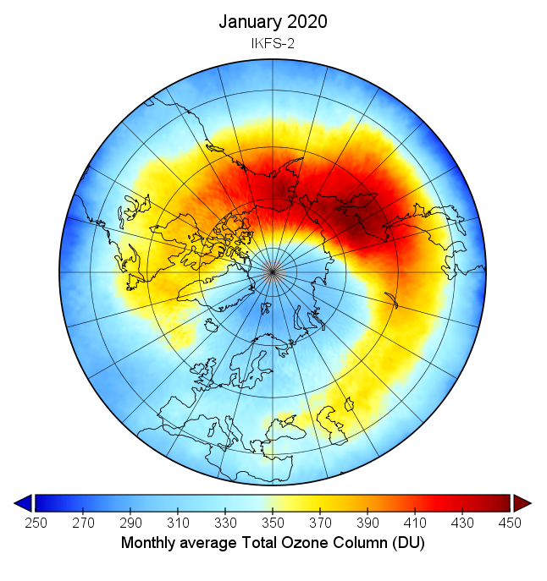
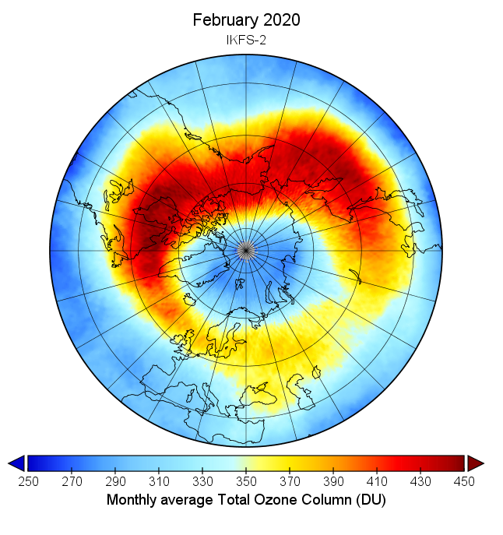
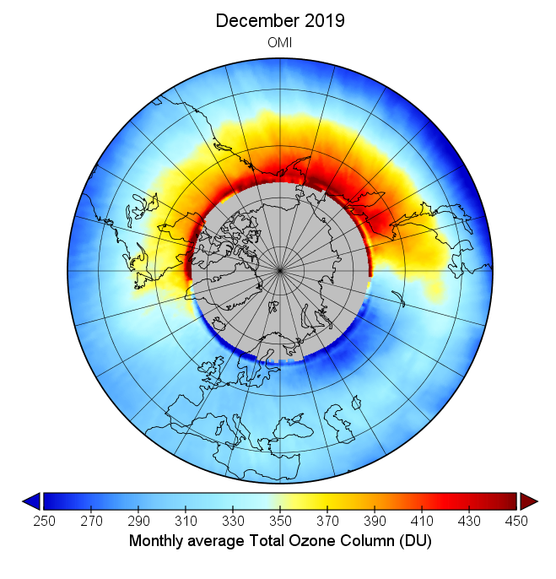
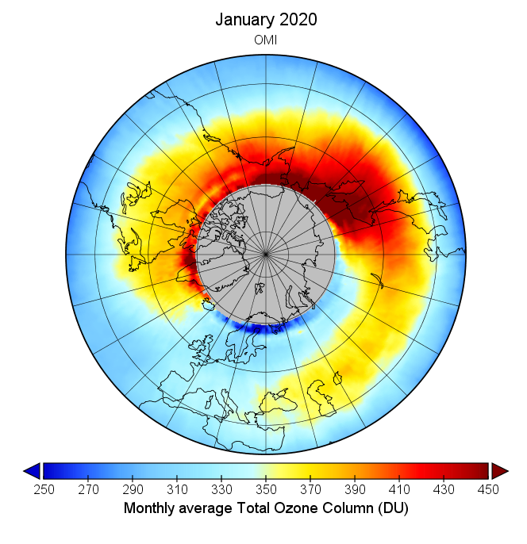
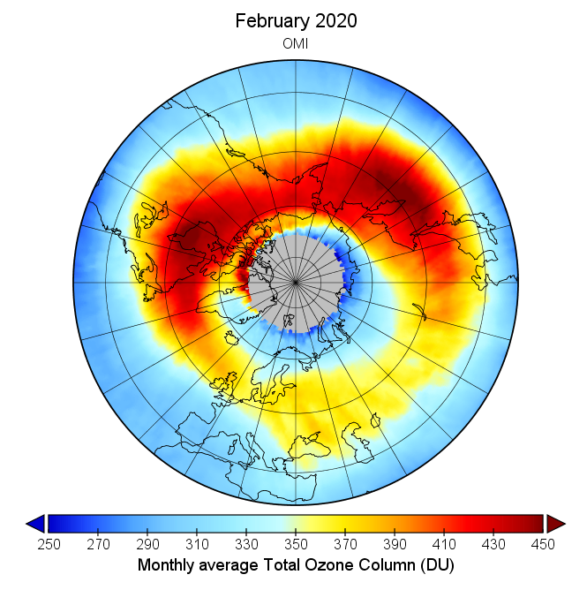
Декабрь 2019
Январь 2020
Февраль 2020
ИКФС-2
OMI

Slide 30
Conclusions:
A technique for estimating the ozone TC based on the IKFS-2 spectra based on the GC and ANN methods has been developed.
The errors in the approximation of the OMI data by the applied algorithm for solving the inverse problem are on average 8.3 DU, varying from less than 4 DU to in the tropics up to 6-10 in the Arctic and 10-15 in the Antarctic regions, excluding the winter months, and in the winter months up to 18 DU,
According to the developed technique and ground-based measurement data, the average TO differences range from -0.6 to -0.8%, and the standard deviations of these differences are usually less than 3%.
The average TO differences according to the developed technique and measurement data by the TROPOMI instrument range from -2 to 0%, the standard deviations of the same differences are from 2 to 4%
The advantage of the developed technique (IR method) over measurements with the OMI and TROPOMI equipment (method of scattered and reflected solar radiation), the possibility of measurements during the polar night is shown.

Slide 31
Благодарю за внимание
Thank you for attention
Благодарим НИЦ «Планета» за предоставление доступа к данным спектральных измерений
Исследование выполнено в рамках работы лаборатории «Исследования Озонового слоя и верхней атмосферы» СПбГУ (соглашение с Минобрнауки РФ № 075–15-2021-583). Измерения солнечного излучения выполнялись с использованием аппаратуры ресурсного центра «Геомодель».
The study was carried out in the "Ozone Layer and Upper Atmosphere Research” laboratory of St. Petersburg State University (agreement with the Ministry of Education and Science of the Russian Federation No. 075-15-2021-583).

